Slide 1
Checking and securing plotting a relationship
Graphical representations of linear equations

Slide 2
how to use Oak lessons

Slide 3
I can use a graphical representation to show all of the points (within a range) that satisfy a relationship.

Slide 4
Substitute means to put in place of another. In algebra, substitution can be used to replace variables with values.

Slide 5

Checking and securing plotting a relationship
Checking understanding of plotting a relationship
Securing understanding of plotting a relationship

Slide 6



Checking understanding of plotting a relationship
Andeep and Laura are talking about numbers.
You think of some numbers and I’ll do something to them.
6
What is the relationship between Andeep and Laura’s numbers?
3
4
2
Andeep’s number is always half of Laura’s.
10
5
−2
−1

Slide 7
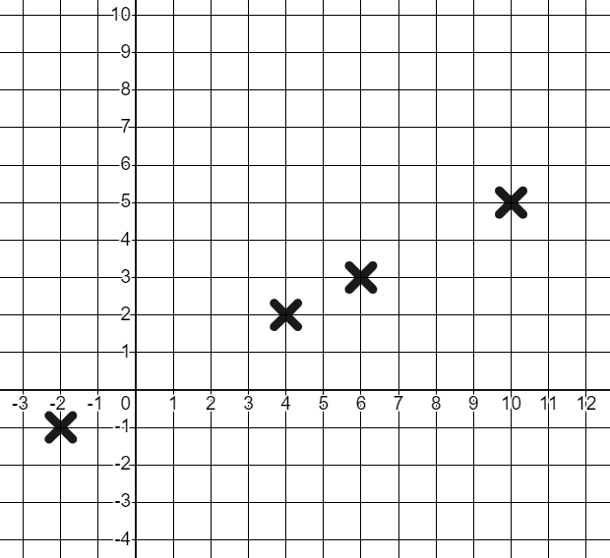
Checking understanding of plotting a relationship
Andeep’s number is always half of Laura’s.
We can represent this relationship graphically.
6
3
Andeep’s number
4
2
10
5
Laura’s number
−2
−1

Slide 8

Checking understanding of plotting a relationship
Checking understanding of plotting a relationship
Identify the relationship that links the x-coordinate to the y-coordinate.
Can you write these as equations using mathematical notation?
a) (0, 2), (3, 5), (5, 7), (8, 10)
The y-coordinate is the x-coordinate plus 2
y = x + 2
+2
+2
+2
+2
b) (0, −2), (2, 0), (4, 2), (7, 5)
The y-coordinate is the x-coordinate minus 2
y = x − 2
−2
−2
−2
−2
c) (0, 0), (2, 4), (3, 6), (5,10)
The y-coordinate is the x-coordinate times 2
y = 2x
×2
×2
×2
×2
d) (0, 10), (2, 8), (3, 7), (7, 3)
The x and y-coordinates sum to 10
x + y = 10
0+10=10
2+8=10
3+7=10
7+3=10

Slide 9
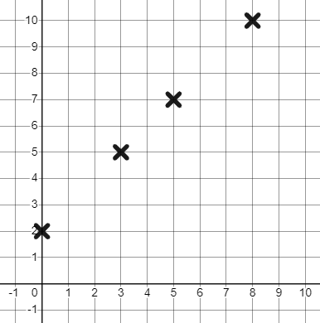
Checking understanding of plotting a relationship
We can plot these points to see the nature of the relationship.
a) (0, 2), (3, 5), (5, 7), (8, 10)
The y-coordinate is the x-coordinate + 2
y = x + 2
A linear relationship.

Slide 10
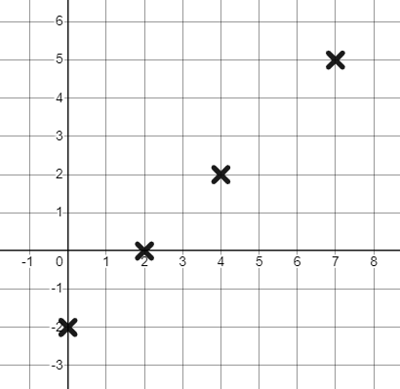
Checking understanding of plotting a relationship
We can plot these points to see the nature of the relationship.
b) (0, −2), (2, 0), (4, 2), (7, 5)
The y-coordinate is the x-coordinate − 2
y = x − 2
A linear relationship.

Slide 11
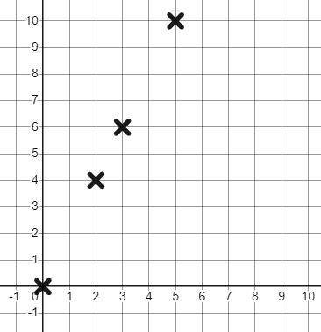
Checking understanding of plotting a relationship
We can plot these points to see the nature of the relationship.
c) (0, 0), (2, 4), (3, 6), (5,10)
The y-coordinate is the x-coordinate × 2
y = 2x
A linear relationship.

Slide 12
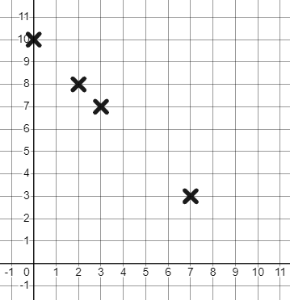
Checking understanding of plotting a relationship
We can plot these points to see the nature of the relationship.
d) (0, 10), (2, 8), (3, 7), (7, 3)
The x and y-coordinates sum to 10
x + y = 10
A linear relationship.

Slide 13

Checking understanding of plotting a relationship
What relationship do you see in these coordinates?
(3, 6), (0, 3), (−3, 0)
The y-coordinate is the x-coordinate plus 3
These coordinates fit the relationship y = x + 3
The y-coordinate is double the x-coordinate
Only true for the first coordinate
The x-coordinate and y-coordinate sum to 3
Only true for the second coordinate

Slide 14
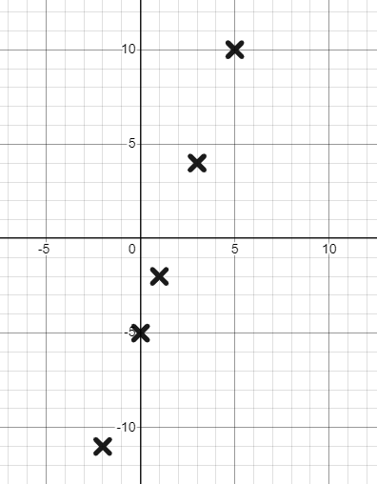
Checking understanding of plotting a relationship
The y-coordinate is three times the x-coordinate then minus 5
What are the remaining missing y-coordinates?
We can work the other way around. We can use a relationship to generate coordinates.
(1, −2)
(0, −5)
(5, 10)
(3, 4)
(−2, −11)
This is the linear relationship y = 3x − 5

Slide 15
Checking understanding of plotting a relationship
= 5(0) + 3
= 0 + 3 = 3
= 5(1) + 3
= 5 + 3 = 8
It can be useful to use a table of values to plot such a relationship.
y = 5x + 3
y = 5x + 3
x | 0 | 1 | 2 | 3 | 4 | 5
y | 3 | 8 | 13 | 18 | 23 | 28
Plotting consecutive integer values of x allows us to more easily see patterns in the y coordinates generated by a relationship.

Slide 16
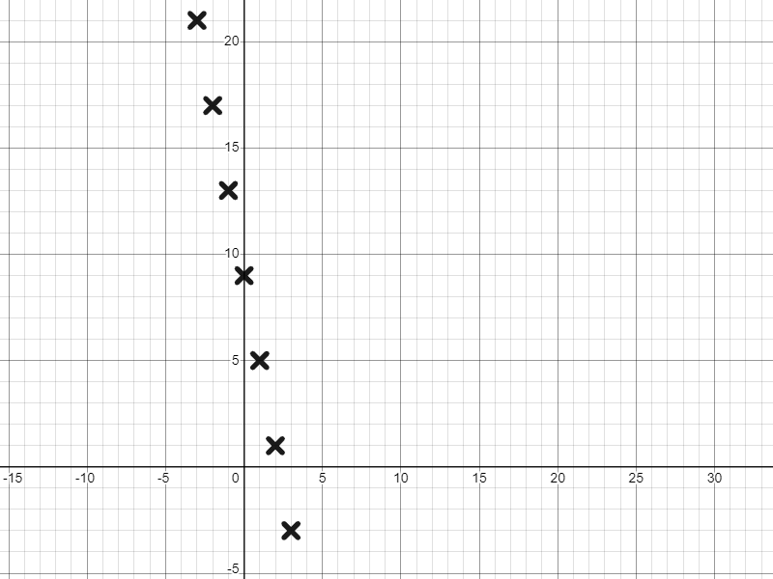
Checking understanding of plotting a relationship
Sometimes we’ll have to substitute negative numbers from a table of values.
y = 9 − 4x
x | −3 | −2 | −1 | 0 | 1 | 2 | 3
y
The linear relationship y = 9 − 4x
x | −3 | −2 | −1 | 0 | 1 | 2 | 3
y |  |  |  | 9 | 5 | 1 | −3
x | −3 | −2 | −1 | 0 | 1 | 2 | 3
y | 21 | 17 | 13 | 9 | 5 | 1 | −3
Start with the zero and positive x values and try to spot a pattern.

Slide 17
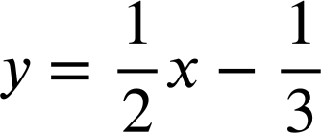








Checking understanding of plotting a relationship
Which are the two missing values from this table of values for the relationship ?
x | −1 | 0 | 1 | 2 | 3 | 4
y

Slide 18
Checking understanding of plotting a relationship
Match the relationship to the table of values.
x | −1 | 0 | 1 | 2 | 3
y | 7 | 5 | 3 | 1 | −1
y = x + 5
x | 0 | 1 | 2 | 3 | 4
y | 5 | 4 | 3 | 2 | 1
y = 5 − 2x
x | −2 | −1 | 0 | 1 | 2
y | −9 | −7 | −5 | −3 | −1
x + y = 5
x | −4 | −3 | −2 | −1 | 0
y | 1 | 2 | 3 | 4 | 5
y = 2x − 5

Slide 19
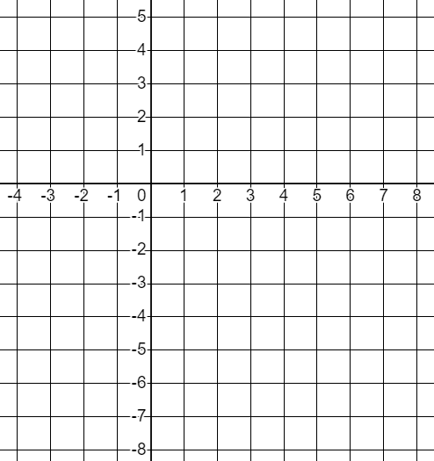
Checking understanding of plotting a relationship
1) Laura says...
Whatever number Andeep chooses I’m going to subtract 4 from it.
Laura’s number
Andeep’s number
Plot some points to graphically represent this relationship.

Slide 20
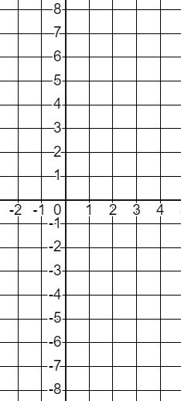
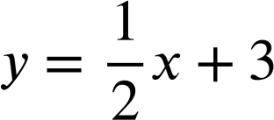
Checking understanding of plotting a relationship
2) Complete the tables of values and plot these relationships.
a)
x | −2 | −1 | 0 | 1 | 2 | 3 | 4
y
y = 2x − 3
b)
x | −2 | −1 | 0 | 1 | 2 | 3 | 4
y
x + y = 4
c)
x | −2 | −1 | 0 | 1 | 2 | 3 | 4
y
d)
x | −2 | −1 | 0 | 1 | 2 | 3 | 4
y
y = 4 − 2x

Slide 21
Checking understanding of plotting a relationship
3) Complete the tables of values for this relationship.
y = 1.5x − 0.8
x | 0 | 0.2 | 0.4 | 0.6 | 0.8 | 1
y
Draw suitable axes to graphically represent the coordinates.

Slide 22
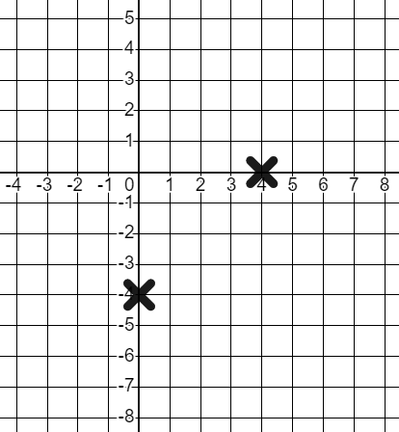
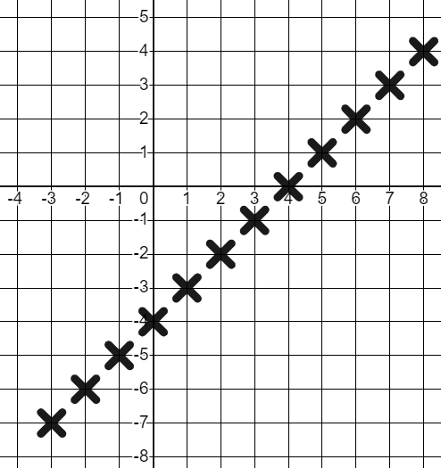
Checking understanding of plotting a relationship
1) Laura says...
Whatever number Andeep chooses I’m going to subtract 4 from it.
Laura’s number
Andeep’s number
Plot some points to graphically represent this relationship.

Slide 23
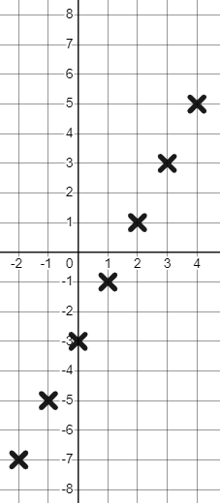
Checking understanding of plotting a relationship
2) Complete the tables of values and plot these relationships.
a)
x | −2 | −1 | 0 | 1 | 2 | 3 | 4
y | −7 | −5 | −3 | −1 | 1 | 3 | 5
x | −2 | −1 | 0 | 1 | 2 | 3 | 4
y
y = 2x − 3

Slide 24
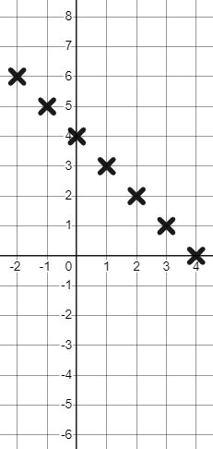
Checking understanding of plotting a relationship
2) Complete the tables of values and plot these relationships.
b)
x | −2 | −1 | 0 | 1 | 2 | 3 | 4
y
x | −2 | −1 | 0 | 1 | 2 | 3 | 4
y | 6 | 5 | 4 | 3 | 2 | 1 | 0
x + y = 4

Slide 25
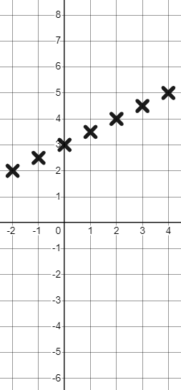
Checking understanding of plotting a relationship
2) Complete the tables of values and plot these relationships.
c)
x | −2 | −1 | 0 | 1 | 2 | 3 | 4
y
x | −2 | −1 | 0 | 1 | 2 | 3 | 4
y | 2 | 2.5 | 3 | 3.5 | 4 | 4.5 | 5

Slide 26
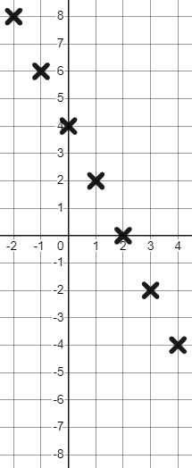
Checking understanding of plotting a relationship
2) Complete the tables of values and plot these relationships.
d)
x | −2 | −1 | 0 | 1 | 2 | 3 | 4
y
x | −2 | −1 | 0 | 1 | 2 | 3 | 4
y | 8 | 6 | 4 | 2 | 0 | −2 | −4
y = 4 − 2x

Slide 27
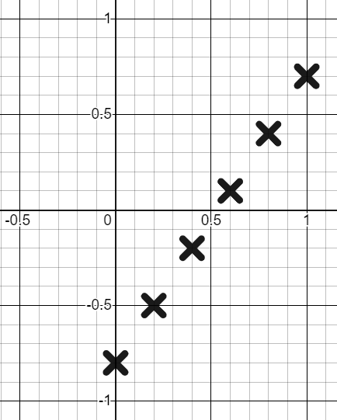
Checking understanding of plotting a relationship
3) Complete the tables of values for this relationship.
y = 1.5x − 0.8
x | 0 | 0.2 | 0.4 | 0.6 | 0.8 | 1
y | −0.8 | −0.5 | −0.2 | 0.1 | 0.4 | 0.7
Draw suitable axes to graphically represent the coordinates.

Slide 28
Checking and securing plotting a relationship
Checking understanding of plotting a relationship
Securing understanding of plotting a relationship

Slide 29
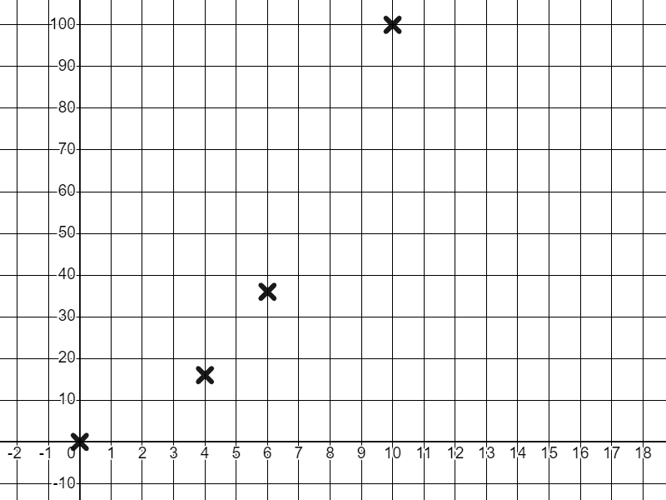
Securing understanding of plotting a relationship
Andeep’s number is always the square of Laura’s.
We can represent this relationship graphically.
6
Andeep’s number
36
4
16
10
100
Andeep
Laura
Laura’s number
0
0

Slide 30
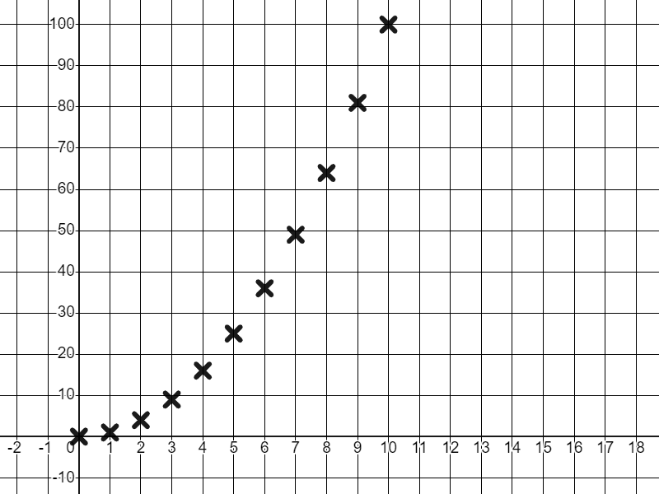
Securing understanding of plotting a relationship
It’s a non-linear relationship! We now have a curve.
All the points on the curve will satisfy the relationship
“Andeep’s number = Laura’s squared”
A = L²
Andeep’s number
3
9
7
49
Laura’s number
10
100

Slide 31
Securing understanding of plotting a relationship
All relationships we plot are linear.
We always get a common difference and that plots a straight line.
Some relationships are linear, some are non-linear and have other shapes like curves rather than lines.

Slide 32
Securing understanding of plotting a relationship
So do all non-linear relationships always form an upward curve?
Andeep’s number
Laura’s number

Slide 33



Securing understanding of plotting a relationship
We’ve been given 60 cookies and told to share them but I’m the only one here. Yay! I get all 60.
Sorry Izzy. You’re going to have to share them now. 60 ÷ 2 = 30 so we’ll get 30 each.
Izzy
I love cookies! No way I’m missing out. 60 ÷ 3 = 20 We now have 20 each.
Sam
What does this relationship look like?
Can we plot it?
Jun

Slide 34
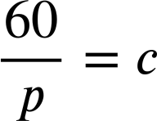
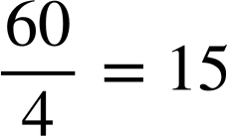
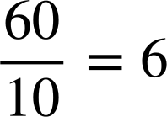
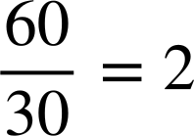
Securing understanding of plotting a relationship
60 cookies shared by the number of people in the room.
People (p) | 1 | 2 | 3 | 4 | 5 | 6 | 10 | 12 | 15 | 20 | 30 | 60
Cookies (c) | 60 | 30 | 20 | 15 | 12 | 10 | 6 | 5 | 4 | 3 | 2 | 1
People (p) | 1 | 2 | 3 | 4 | 5 | 6 | 10 | 12 | 15 | 20 | 30 | 60
Cookies (c) | 60 | 30 | 20
People (p) | 1 | 2 | 3 | 4 | 5 | 6 | 10 | 12 | 15 | 20 | 30 | 60
Cookies (c)
How might we describe this relationship?

Slide 35
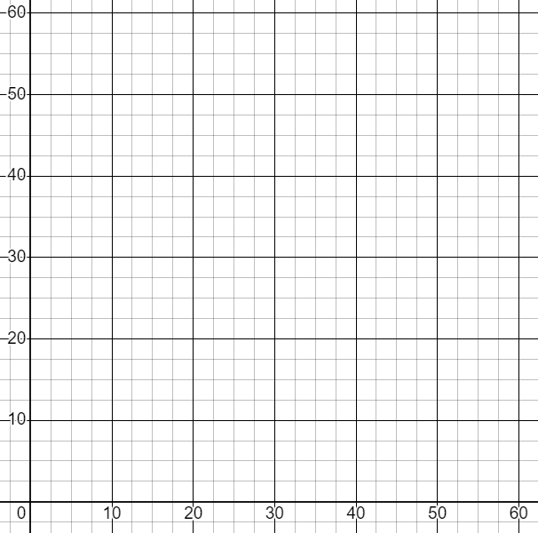
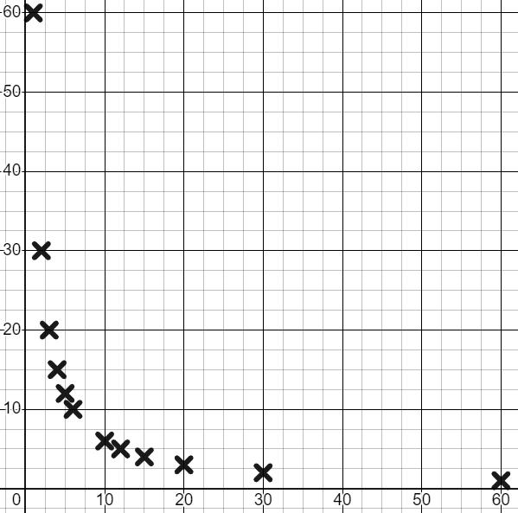
Securing understanding of plotting a relationship
60 cookies shared by the number of people in the room.
People (p) | 1 | 2 | 3 | 4 | 5 | 6 | 10 | 12 | 15 | 20 | 30 | 60
Cookies (c) | 60 | 30 | 20 | 15 | 12 | 10 | 6 | 5 | 4 | 3 | 2 | 1
Cookies (c)
How will the relationship look when plotted?
People (p)

Slide 36
Securing understanding of plotting a relationship
Which words might you use to describe this relationship?
Curve
Cookies (c)
Decreasing
Linear
People (p)
We can model all sorts of relationships in maths; they won’t all be linear.

Slide 37
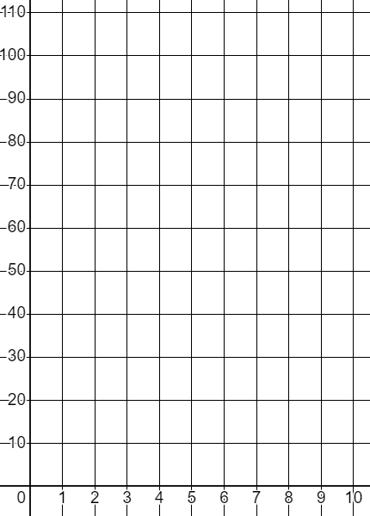
Securing understanding of plotting a relationship
1) This time Andeep is squaring Laura’s number and adding 10.
Laura (L) | 1 | 2 | 3 | 4 | 5 | 6 | 7 | 8 | 9 | 10
Andeep (A) | 11 |  |  |  | 35
1
11
5
Andeep’s number
35
a) Complete the table of values and plot the relationship.
b) Explain why (5,25) is not on this curve.
Laura’s number
c) Write this relationship algebraically.

Slide 38
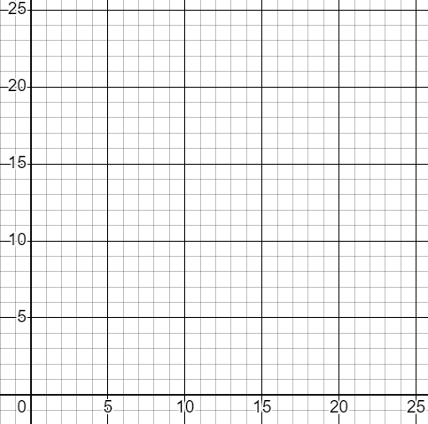
Securing understanding of plotting a relationship
2) This time the Oak pupils are sharing 24 apples.
People (p) | 1 | 2 | 3 | 4 | 6 | 8 | 12 | 24
Apples (a)
a) Complete the table of values and plot the relationship.
Apples (a)
b) Write this relationship algebraically.
People (p)

Slide 39
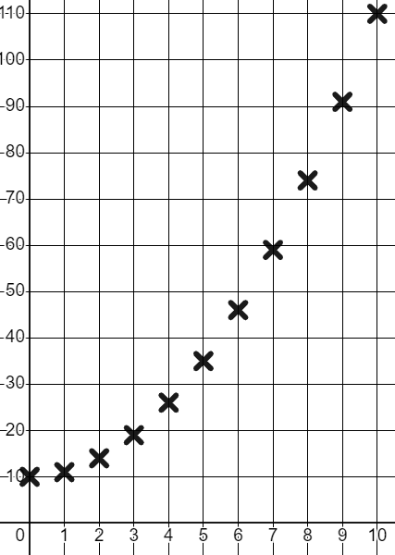
Securing understanding of plotting a relationship
1) This time Andeep is squaring Laura’s number and adding 10.
Laura (L) | 1 | 2 | 3 | 4 | 5 | 6 | 7 | 8 | 9 | 10
Andeep (A) | 11 | 14 | 19 | 26 | 35 | 46 | 59 | 74 | 91 | 110
Laura (L) | 1 | 2 | 3 | 4 | 5 | 6 | 7 | 8 | 9 | 10
Andeep (A) | 11 |  |  |  | 35
1
11
5
35
Andeep’s number
a) Complete the table of values and plot the relationship.
b) Explain why (5,25) is not on this curve.
It does not fit the relationship. 5² + 10 ≠ 25
Laura’s number
c) Write this relationship algebraically.
A = L² + 10

Slide 40
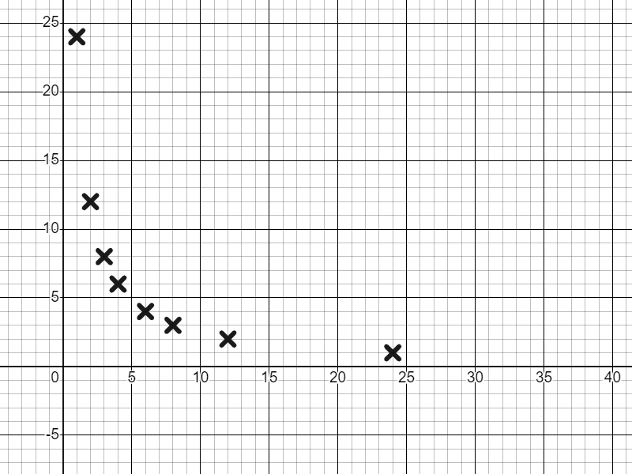
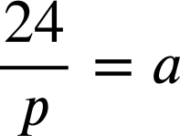
Securing understanding of plotting a relationship
2) This time the Oak pupils are sharing 24 apples.
People (p) | 1 | 2 | 3 | 4 | 6 | 8 | 12 | 24
Apples (a) | 24 | 12 | 8 | 6 | 4 | 3 | 2 | 1
People (p) | 1 | 2 | 3 | 4 | 6 | 8 | 12 | 24
Apples (a)
a) Complete the table of values and plot the relationship.
Apples (a)
b) Write this relationship algebraically.
People (p)

Slide 41
Checking and securing plotting a relationship
We can use graphical representations to show all the points that satisfy a mathematical relationship.
Sometimes the relationship is linear, sometimes it is non-linear however, all points on the line or curve satisfy the relationship.

Slide 42

© Oak National Academy 2023.
Produced in partnership with Mathematics in Education and Industry.
Licensed on the Open Government Licence v3.0, except where otherwise stated. See Oak terms and conditions.

